Slide 1
Module 8: Access Control Lists
Networking Security v1.0
(NETSEC)
Notes:
Networking Security (NETSEC) Module 8: Access Control Lists

Slide 2
Module Objectives
Module Title: Access Control Lists
Module Objective: Implement access control lists (ACLs) to filter traffic and mitigate network attacks on a network.
Topic Title | Topic Objective
Introduction to Access Control Lists | Describe standard and extended ACLs.
Wildcard Masks | Explain how ACLs use wildcard masks.
Configure ACLs | Explain how to configure ACLs.
Modify ACLs | Use sequence numbers to edit existing standard IPv4 ACLs.
Implement ACLs | Implement ACLs.
Mitigate Attacks with ACLs | Use ACLs to mitigate common network attacks.
IPv6 ACLs | Configure IPv6 ACLs using CLI.
Notes:
2

Slide 3
8.1 Introduction to Access Control Lists
Notes:
8: Access Control Lists 8.1: Introduction to Access Control Lists

Slide 4
Introduction to Access Control Lists
What is an ACL?
An ACL is a series of IOS commands that are used to filter packets based on information found in the
packet header.
Task | Example
Limit network traffic to increase network performance | A corporate policy prohibits video traffic on the network to reduce the network load. A policy can be enforced using ACLs to block video traffic.
Provide traffic flow control | A corporate policy requires that routing protocol traffic be limited to certain links only. A policy can be implemented using ACLs to restrict the delivery of routing updates to only those that come from a known source.
Provide a basic level of security for network access | Corporate policy demands that access to the Human Resources network be restricted to authorized users only. A policy can be enforced using ACLs to limit access to specified networks.
Filter traffic based on traffic type | Corporate policy requires that email traffic be permitted into a network, but that Telnet access be denied. A policy can be implemented using ACLs to filter traffic by type.
Screen hosts to permit or deny access to network services | Corporate policy requires that access to some file types (e.g., FTP or HTTP) be limited to user groups. A policy can be implemented using ACLs to filter user access to services.
Provide priority to certain classes of network traffic | Corporate traffic specifies that voice traffic be forwarded as fast as possible to avoid any interruption. A policy can be implemented using ACLs and QoS services to identify voice traffic and process it immediately.
Notes:
8: Access Control Lists 8.1: Introduction to Access Control Lists 8.1.1: What is an ACL?

Slide 5
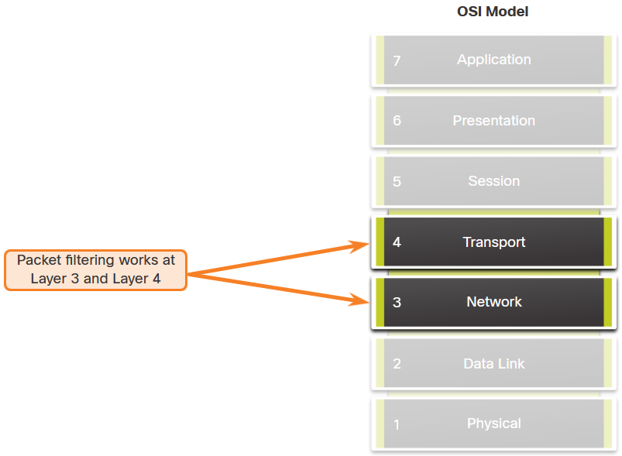
Introduction to Access Control Lists
Packet Filtering
Packet filtering controls access to a network by analyzing the incoming and/or outgoing packets and forwarding them or discarding them based on given criteria. Packet filtering can occur at Layer 3 or Layer 4. Cisco routers support standard and extended ACLs.
Notes:
8: Access Control Lists 8.1: Introduction to Access Control Lists 8.1.2: Packet Filtering

Slide 6
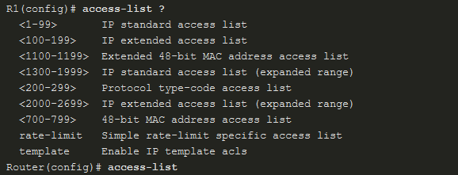

Introduction to Access Control Lists
Numbered and Named ACLs
Numbered ACLs - ACLs number 1 to 99, or 1300 to 1999 are standard ACLs while ACLs number 100 to 199, or 2000 to 2699 are extended ACLs, as shown in the output.
Named ACLs - Named ACLs is the preferred method to use when configuring ACLs. Specifically, standard and extended ACLs can be named to provide information about the purpose of the ACL. The ip access-list global configuration command is used to create a named ACL.
Notes:
8: Access Control Lists 8.1: Introduction to Access Control Lists 8.1.3: Numbered and Named ACLs

Slide 7
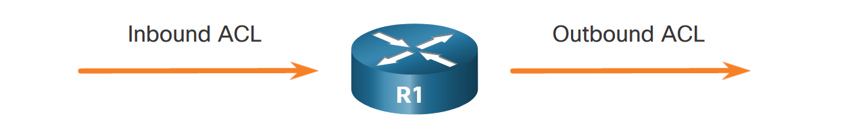
Introduction to Access Control Lists
ACL Operation
ACLs define the set of rules that give added control for packets that enter inbound interfaces, packets that relay through the router, and packets that exit outbound interfaces of the router.
An inbound ACL filters packets before they are routed to the outbound interface. If the packet is permitted by the ACL, it is then processed for routing. Inbound ACLs are best used to filter packets when the network attached to an inbound interface is the only source of packets that need to be examined.
An outbound ACL filters packets after being routed, regardless of the inbound interface. Incoming packets are routed to the outbound interface and then they are processed through the outbound ACL. Outbound ACLs are best used when the same filter will be applied to packets coming from multiple inbound interfaces before exiting the same outbound interface.
Notes:
8: Access Control Lists 8.1: Introduction to Access Control Lists 8.1.4: ACL Operation

Slide 8
Introduction to Access Control Lists
Packet Tracer - ACL Demonstration
In this activity, you will observe how an access control list (ACL) can be used to prevent a ping from reaching hosts on remote networks. After removing the ACL from the configuration, the pings will be successful.
Notes:
8: Access Control Lists 8.1: Introduction to Access Control Lists 8.1.5: Packet Tracer - ACL Demonstration

Slide 9
8.2 Wildcard Masking
Notes:
8: Access Control Lists 8.2: Wildcard Masking

Slide 10
Wildcard Masking
Wildcard Mask Overview
A wildcard mask is like a subnet mask in that it uses the ANDing process to identify which bits in an IPv4 address to match. However, they differ in the way they match binary 1s and 0s. Unlike a subnet mask, in which binary 1 is equal to a match and binary 0 is not a match, in a wildcard mask, the reverse is true.
Wildcard Mask | Last Octet (in Binary) | Meaning (0 - match, 1 - ignore)
0.0.0.0 | 00000000 | Match all octets.
0.0.0.63 | 00111111 | Match the first three octets Match the two left most bits of the last octet Ignore the last 6 bits
0.0.0.15 | 00001111 | Match the first three octets Match the four left most bits of the last octet Ignore the last 4 bits of the last octet
0.0.0.252 | 11111100 | Match the first three octets Ignore the six left most bits of the last octet Match the last two bits
0.0.0.255 | 11111111 | Match the first three octet Ignore the last octet
Notes:
8: Access Control Lists 8.2: Wildcard Masking 8.2.1: Wildcard Mask Overview

Slide 11
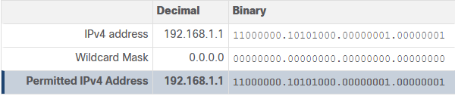
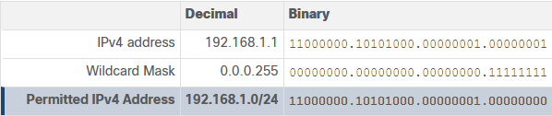
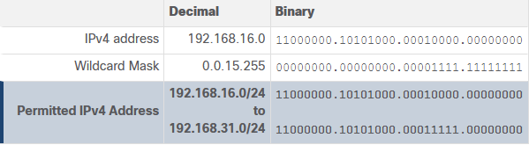
Wildcard Masking
Wildcard Mask Types
Wildcard Mask to Match a Host
Wildcard Mask to Match an IPv4 Subnet
Wildcard Mask to Match an IPv4 Address Range
Notes:
8: Access Control Lists 8.2: Wildcard Masking 8.2.2: Wildcard Mask Types

Slide 12
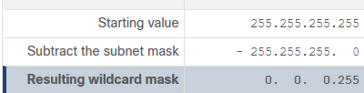
Wildcard Masking
Wildcard Mask Calculation
Calculating wildcard masks can be challenging. One shortcut method is to subtract the subnet mask from 255.255.255.255.
Assume you wanted an ACE in ACL 10 to permit access to all users in the 192.168.3.0/24 network. To calculate the wildcard mask, subtract the subnet mask (i.e., 255.255.255.0) from 255.255.255.255, as shown in the table.
The solution produces the wildcard mask 0.0.0.255. Therefore, the ACE would be access-list 10 permit 192.168.3.0 0.0.0.255.
Notes:
8: Access Control Lists 8.2: Wildcard Masking 8.2.3: Wildcard Mask Calculation

Slide 13

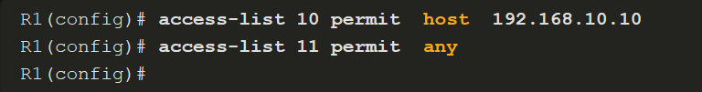
Wildcard Masking
Wildcard Mask Keywords
Keywords reduce ACL keystrokes and make it easier to read the ACE:
host - This keyword substitutes for the 0.0.0.0 mask. This mask states that all IPv4 address bits must match to filter just one host address.
any - This keyword substitutes for the 255.255.255.255 mask. This mask says to ignore the entire IPv4 address or to accept any addresses.
For example, these ACL commands…
…can be rewritten as follows:
Notes:
8: Access Control Lists 8.2: Wildcard Masking 8.2.4: Wildcard Mask Keywords
8.2.5: Check Your Understanding – Wildcard Masks in ACLs

Slide 14
8.3 Configure ACLs
Notes:
8: Access Control Lists 8.3: Configure ACLs

Slide 15
Configure ACLs
Create an ACL
When configuring a complex ACL, it is suggested that you:
Use a text editor and write out the specifics of the policy to be implemented.
Add the IOS configuration commands to accomplish those tasks.
Include remarks to document the ACL.
Copy and paste the commands onto the device.
Always thoroughly test an ACL to ensure that it correctly applies the desired policy.
Notes:
8: Access Control Lists 8.3: Configure ACLs 8.3.1: Create an ACL

Slide 16
Configure ACLs
Numbered Standard IPv4 ACL Syntax
To create a numbered standard ACL, use the following global configuration command:
Use the no access-list access-list-number global configuration command to remove a numbered standard ACL.
Notes:
8: Access Control Lists 8.3: Configure ACLs 8.3.2: Numbered Standard IPv4 ACL Syntax

Slide 17
Configure ACLs
Numbered Standard IPv4 ACL Syntax (Cont.)
This table provides a detailed explanation of the syntax for a standard ACL.
Parameter | Description
access-list-number | This is the decimal number of the ACL. Standard ACL number range is 1 to 99 or 1300 to 1999.
deny | This denies access if the condition is matched.
permit | This permits access if the condition is matched.
remark text | (Optional) This adds a text entry for documentation purposes. Each remark is limited to 100 characters.
source | This identifies the source network or host address to filter. Use the any keyword to specify all networks. Use the host ip-address keyword or simply enter an ip-address (without the host keyword) to identify a specific IP address.
source-wildcard | (Optional) This is a 32-bit wildcard mask that is applied to the . If omitted, a default 0.0.0.0 mask is assumed.
log | (Optional) This keyword generates and sends an informational message whenever the ACE is matched. Message includes ACL number, matched condition (i.e., permitted or denied), source address, and number of packets.{`{" "}`} This message is generated for the first matched packet. This keyword should only be implemented for troubleshooting or security reasons.
Notes:
8: Access Control Lists 8.3: Configure ACLs 8.3.2: Numbered Standard IPv4 ACL Syntax (Cont.)

Slide 18
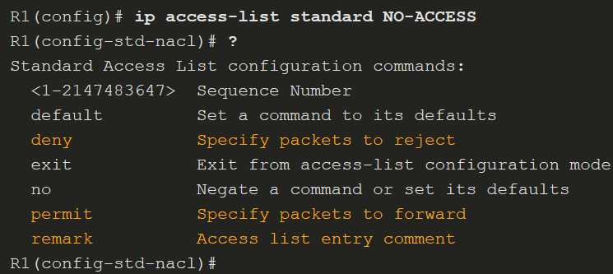
Configure ACLs
Named Standard IPv4 ACL Syntax
ACL names are alphanumeric, case sensitive, and must be unique. Capitalizing ACL names is recommended. To create a named standard ACL, use the following global configuration command:
In the example, a named standard IPv4 ACL called NO-ACCESS is created. Notice that the prompt changes to named standard ACL configuration mode. Use the help facility to view all the named standard ACL ACE options.
Notes:
8: Access Control Lists 8.3: Configure ACLs 8.3.3: Named Standard IPv4 ACL Syntax

Slide 19
Configure ACLs
Numbered Extended IPv4 ACL Syntax
The procedural steps for configuring extended ACLs are the same as for standard ACLs. The extended ACL is first configured, and then it is activated on an interface. However, the command syntax and parameters are more complex to support the additional features provided by extended ACLs.
To create a numbered extended ACL, use the following global configuration command:
The parameters are reviewed on the next two slides.
The command to apply an extended IPv4 ACL to an interface is the same as the command used for standard IPv4 ACLs.
Notes:
8: Access Control Lists 8.3: Configure ACLs 8.3.4: Numbered Extended IPv4 ACL Syntax

Slide 20
Configure ACLs
Numbered Extended IPv4 ACL Syntax (Cont.)
Although there are many keywords and parameters for extended ACLs, it is not necessary to use all of them when configuring an extended ACL. The table provides a detailed explanation of the syntax for an extended ACL.
Parameter | Description
access-list-number | This is the decimal number of the ACL. Extended ACL number range is 100 to 199 and 2000 to 2699.
deny | This denies access if the condition is matched.
permit | This permits access if the condition is matched.
remark text | (Optional) Adds a text entry for documentation purposes. Each remark is limited to 100 characters.
protocol | Name or number of an internet protocol. Common keywords include ip, tcp, udp, and icmp. The ip keyword matches all IP protocols.
source | This identifies the source network or host address to filter. Use the any keyword to specify all networks. Use the host ip-address keyword or simply enter an ip-address (without the host keyword) to identify a specific IP address.
source-wildcard | (Optional) A 32-bit wildcard mask that is applied to the source.
(table continued on next slide)
Notes:
8: Access Control Lists 8.3: Configure ACLs 8.3.4: Numbered Extended IPv4 ACL Syntax (Cont.)

Slide 21
Configure ACLs
Numbered Extended IPv4 ACL Syntax (Cont.)
Parameter | Description
destination | This identifies the destination network or host address to filter. Use the any keyword to specify all networks. Use the host ip-address keyword or ip-address.
destination-wildcard | (Optional) This is a 32-bit wildcard mask that is applied to the destination.
operator | (Optional) This compares source or destination ports. Some operators include lt (less than), gt (greater than), eq (equal), and neq (not equal).
port | (Optional) The decimal number or name of a TCP or UDP port.
established | (Optional) For the TCP protocol only. This is a 1st generation firewall feature.
log | (Optional) This keyword generates and sends an informational message whenever the ACE is matched. This message includes ACL number, matched condition (i.e., permitted or denied), source address, and number of packets. This message is generated for the first matched packet. This keyword should only be implemented for troubleshooting or security reasons.
Notes:
8: Access Control Lists 8.3: Configure ACLs 8.3.4: Numbered Extended IPv4 ACL Syntax (Cont.)

Slide 22
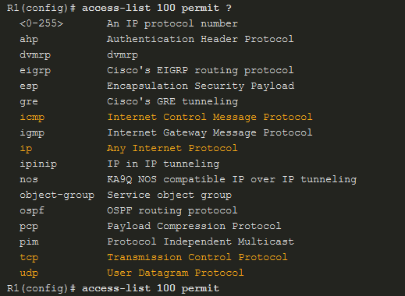
Configure ACLs
Protocols and Port Numbers
Protocol Options - The four highlighted protocols are the most popular options. Use the ? to get help when entering a complex ACE. If an internet protocol is not listed, then the IP protocol number could be specified. For instance, the ICMP protocol number 1, TCP is 6, and UDP is 17.
Notes:
8: Access Control Lists 8.3: Configure ACLs 8.3.5: Protocols and Port Numbers

Slide 23
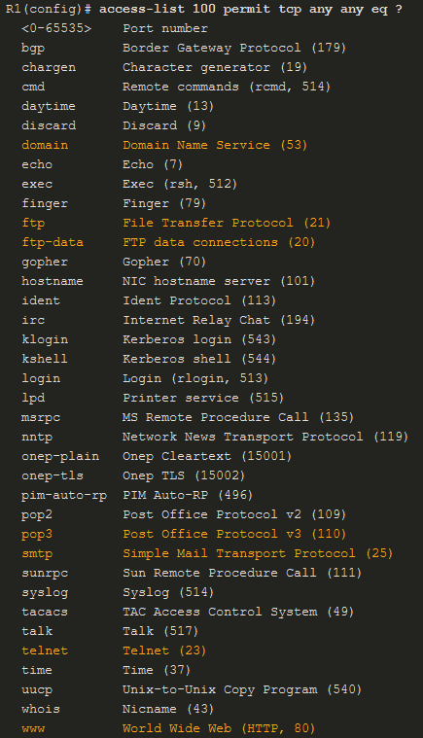
Configure ACLs
Protocols and Port Numbers (Cont.)
Port Keyword Options - Selecting a protocol influences port options. For instance, selecting the:
tcp protocol would provide TCP related ports options
udp protocol would provide UDP specific ports options
icmp protocol would provide ICMP related ports (i.e., message) options
Notice how many TCP port options are available. The highlighted ports are popular options. Port names or number can be specified. However, port names make it easier to understand the purpose of an ACE. Notice how some common ports names (e.g., SSH and HTTPS) are not listed. For these protocols, port numbers will have to be specified.
Notes:
8: Access Control Lists 8.3: Configure ACLs 8.3.5: Protocols and Port Numbers (Cont.)

Slide 24
Configure ACLs
Protocols and Port Numbers Configuration Examples
Extended ACLs can filter on different port number and port name options. This example configures an extended ACL 100 to filter HTTP traffic. The first ACE uses the www port name. The second ACE uses the port number 80. Both ACEs achieve exactly the same result.
Configuring the port number is required when there is not a specific protocol name listed such as SSH (port number 22) or an HTTPS (port number 443)
Notes:
8: Access Control Lists 8.3: Configure ACLs 8.3.6: Protocols and Port Numbers Configuration Examples

Slide 25
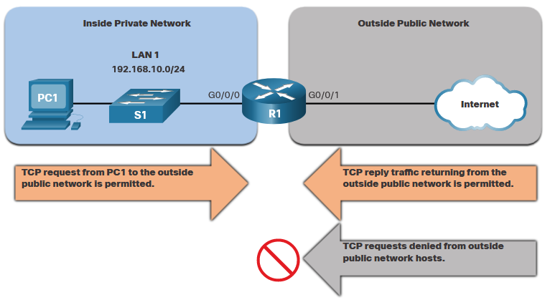
Configure ACLs
TCP Established Extended ACL
TCP can also perform basic stateful firewall services using the TCP established keyword. The keyword enables inside traffic to exit the inside private network and permits the returning reply traffic to enter the inside private network. However, TCP traffic generated by an outside host and attempting to communicate with an inside host is denied. The established keyword can be used to permit only the return HTTP traffic from requested websites, while denying all other traffic.
Notes:
8: Access Control Lists 8.3: Configure ACLs 8.3.7: TCP Established Extended ACL

Slide 26
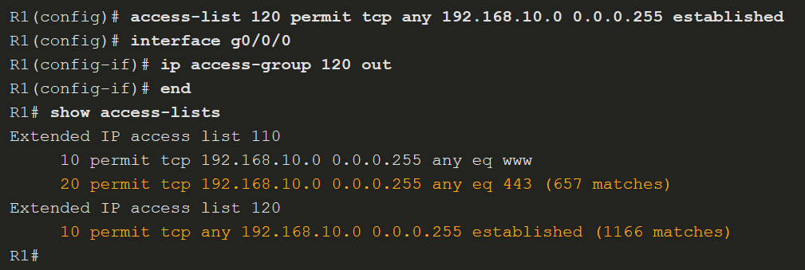
Configure ACLs
TCP Established Extended ACL (Cont.)
In this example, ACL 120 is configured to only permit returning web traffic to the inside hosts. The new ACL is then applied outbound on the R1 G0/0/0 interface. The show access-lists command displays both ACLs. Notice from the match statistics that inside hosts have been accessing the secure web resources from the internet.
Notes:
8: Access Control Lists 8.3: Configure ACLs 8.3.7: TCP Established Extended ACL

Slide 27
Configure ACLs
Named Extended IPv4 ACL Syntax
Naming an ACL makes it easier to understand its function. This command enters the named extended configuration mode. Recall that ACL names are alphanumeric, case sensitive, and must be unique. To create a named extended ACL, use the following global configuration command:
In the example, a named extended ACL called NO-FTP-ACCESS is created and the prompt changed to named extended ACL configuration mode. ACE statements are entered in the named extended ACL sub configuration mode.
Notes:
8: Access Control Lists 8.3: Configure ACLs 8.3.8: Named Extended IPv4 ACL Syntax

Slide 28
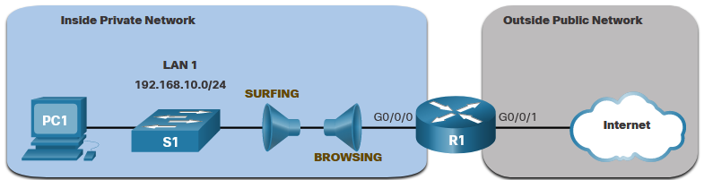
Configure ACLs
Named Extended IPv4 ACL Example
Named extended ACLs are created in essentially the same way that named standard ACLs are created. The topology in the figure is used to demonstrate configuring and applying two named extended IPv4 ACLs to an interface:
SURFING - This will permit inside HTTP and HTTPS traffic to exit to the internet.
BROWSING - This will only permit returning web traffic to the inside hosts while all other traffic exiting the R1 G0/0/0 interface is implicitly denied.
Notes:
8: Access Control Lists 8.3: Configure ACLs 8.3.9: Named Extended IPv4 ACL Example

Slide 29
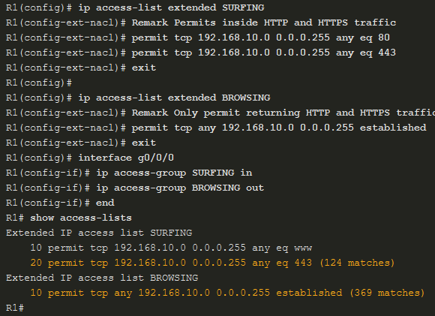
Configure ACLs
Named Extended IPv4 ACL Example (Cont.)
The SURFING ACL permits HTTP and HTTPS traffic from inside users to exit the G0/0/1 interface connected to the internet. Web traffic returning from the internet is permitted back into the inside private network by the BROWSING ACL.
The SURFING ACL is applied inbound and the BROWSING ACL applied outbound on the R1 G0/0/0 interface.
Inside hosts have been accessing the secure web resources from the internet. The show access-lists command is used to verify the ACL statistics.
Notes:
8: Access Control Lists 8.3: Configure ACLs 8.3.9: Named Extended IPv4 ACL Example (Cont.)

Slide 30
8.4 Modify ACLs
Notes:
8: Access Control Lists 8.4: Modify ACLs

Slide 31
Modify ACLs
Two Methods to Modify an ACL
After an ACL is configured, it may need to be modified. ACLs with multiple ACEs can be complex to configure. Sometimes the configured ACE does not yield the expected behaviors. For these reasons, ACLs may initially require a bit of trial and error to achieve the desired filtering result. There are two methods to use when modifying an ACL:
Use a Text Editor
Use Sequence Numbers
Notes:
8: Access Control Lists 8.4: Modify ACLs 8.4.1: Two Methods to Modify an ACL

Slide 32
Modify ACLs
Text Editor Method
ACLs with multiple ACEs should be created in a text editor. This allows you to plan the required ACEs, create the ACL, and then paste it into the router interface. It also simplifies the tasks to edit and fix an ACL. To modify an ACL using a text editor:
Copy the ACL from the running configuration and paste it into the text editor.
Make the necessary edits changes.
Remove the previously configured ACL on the router otherwise, pasting the edited ACL commands will only append (i.e., add) to the existing ACL ACEs on the router.
Copy and paste the edited ACL back to the router.
Notes:
8: Access Control Lists 8.4: Modify ACLs 8.4.2: Text Editor Method

Slide 33
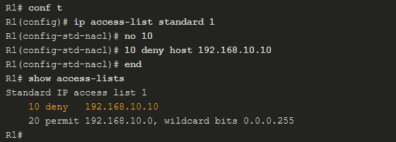
Modify ACLs
Sequence Number Method
An ACL ACE can also be deleted or added using the ACL sequence numbers. Sequence numbers are automatically assigned when an ACE is entered. These numbers are listed in the show access-lists command. The show running-config command does not display sequence numbers.
Use the ip access-list standard command to edit an ACL. Statements cannot be overwritten using the same sequence number as an existing statement. Therefore, the current statement must be deleted first with the no 10 command. Then the correct ACE can be added using sequence number 10 as configured. Verify the changes using the show access-lists command.
Notes:
8: Access Control Lists 8.4: Modify ACLs 8.4.3: Sequence Number Method
8.4.4: Syntax Checker - Modify IPv4 ACLs

Slide 34
8.5 Implement ACLs
Notes:
8: Access Control Lists 8.5: Implement ACLs

Slide 35
Implement ACLs
ACL Configuration Guidelines
An ACL is made up of one or more access control entries (ACEs) or statements. When configuring and applying an ACL, be aware of the guidelines summarized in this list:
Create an ACL globally and then apply it.
Ensure the last statement is an implicit deny any or deny ip any any.
Remember that statement order is important because ACLs are processed top-down.
As soon as a statement is matched the ACL is exited.
Ensure that the most specific statements are at the top of the list.
Remember that only one ACL is allowed per interface, per protocol, per direction.
Remember that new statements for an existing ACL are added to the bottom of the ACL by default.
Remember that router-generated packets are not filtered by outbound ACLs.
Place standard ACLs as close to the destination as possible.
Place extended ACLs as close to the source as possible.
Notes:
8: Access Control Lists 8.5: Implement ACLs 8.5.1: ACL Configuration Guidelines

Slide 36
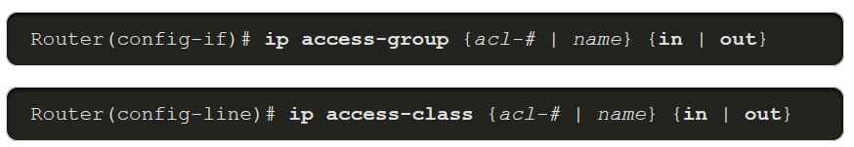
Implement ACLs
Apply an ACL
After creating an ACL, the administrator can apply it in a number of different ways. The following shows the command syntax to apply an ACL to an interface or to the vty lines.
Notes:
8: Access Control Lists 8.5: Implement ACLs 8.5.2: Apply an ACL

Slide 37
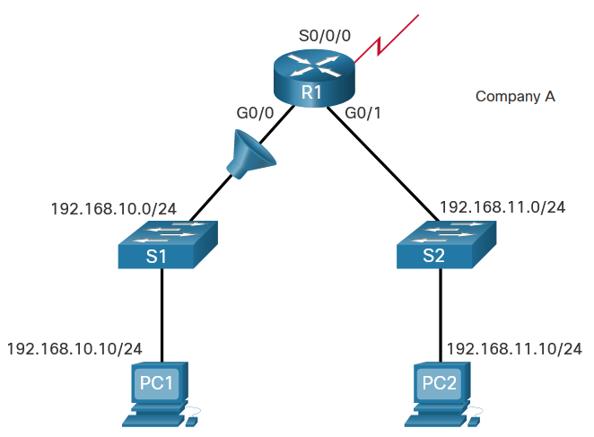
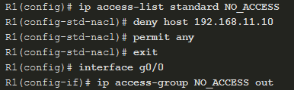
Implement ACLs
Apply an ACL (Cont.)
The figure below shows a named standard ACL applied to outbound traffic.
Notes:
8: Access Control Lists 8.5: Implement ACLs 8.5.2: Apply an ACL (Cont.)

Slide 38
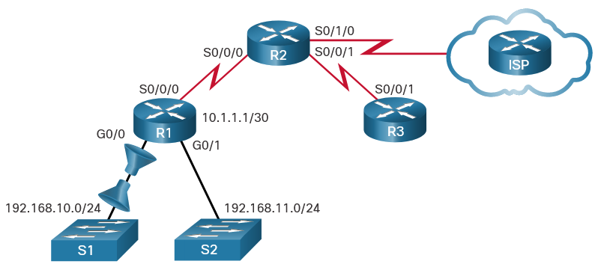
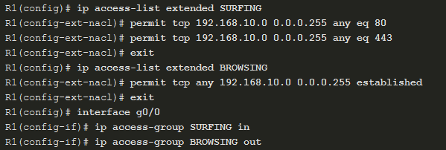
Implement ACLs
Apply an ACL (Cont.)
This figure shows two named extended ACLs. The SURFING ACL is applied to inbound traffic and the BROWSING ACL is applied to outbound traffic.
Notes:
8: Access Control Lists 8.5: Implement ACLs 8.5.2: Apply an ACL (Cont.)

Slide 39
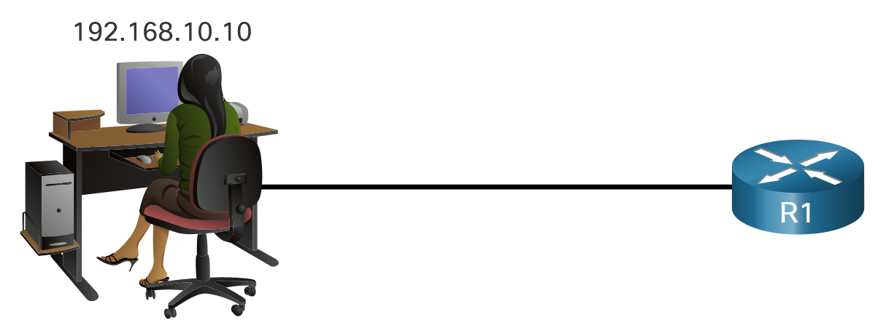
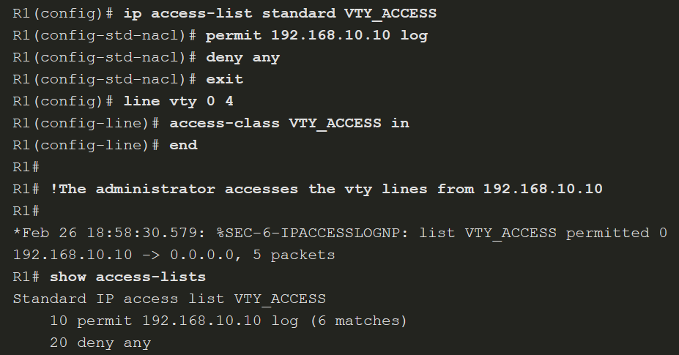
Implement ACLs
Apply an ACL (Cont.)
This example shows an ACL applied to the vty lines.
Notes:
8: Access Control Lists 8.5: Implement ACLs 8.5.2: Apply an ACL (Cont.)

Slide 40
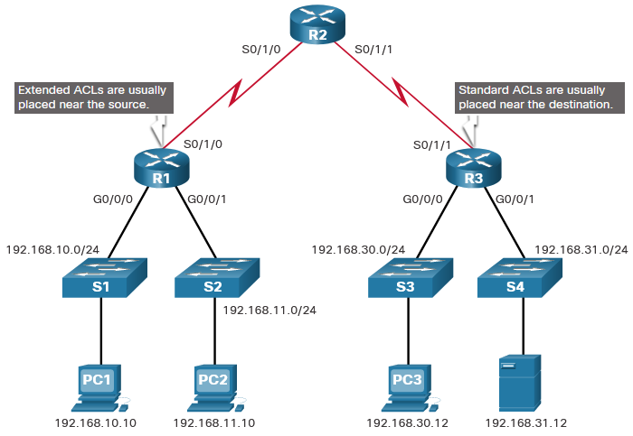
Implement ACLs
Where to Place ACLs
Every ACL should be placed where it is the most efficient.
The figure illustrates where standard and extended ACLs should be located in an enterprise network. Assume the objective is to prevent traffic that originates in the 192.168.10.0/24 network from reaching the 192.168.30.0/24 network.
Notes:
8: Access Control Lists 8.5: Implement ACLs 8.5.3: Where to Place ACLs

Slide 41
Implement ACLs
Where to Place ACLs (Cont.)
Placement of the ACL and therefore, the type of ACL used, may also depend on a variety of factors as listed in the table.
Factors Influencing ACL Placement | Explanation
The extent of organizational control | Placement of the ACL can depend on whether or not the organization has control of both the source and destination networks.
Bandwidth of the networks involved | It may be desirable to filter unwanted traffic at the source to prevent transmission of bandwidth-consuming traffic.
Ease of configuration | It may be easier to implement an ACL at the destination, but traffic will use bandwidth unnecessarily. An extended ACL could be used on each router where the traffic originated. This would save bandwidth by filtering the traffic at the source, but it would require creating extended ACLs on multiple routers.
Notes:
8: Access Control Lists 8.5: Implement ACLs 8.5.3: Where to Place ACLs (Cont.)

Slide 42
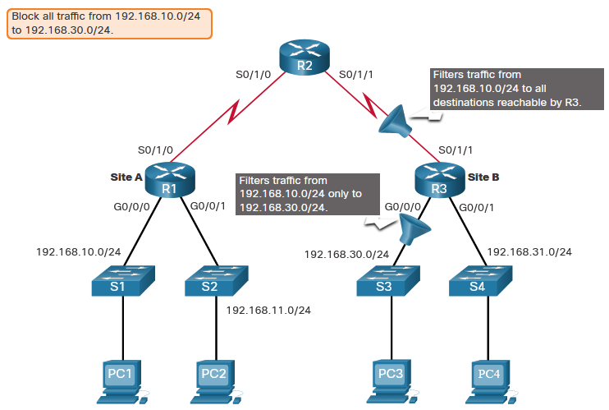
Implement ACLs
Standard ACL Placement Example
Following the guidelines for ACL placement, standard ACLs should be located as close to the destination as possible. In the figure, the administrator wants to prevent traffic originating in the 192.168.10.0/24 network from reaching the 192.168.30.0/24 network.
Notes:
8: Access Control Lists 8.5: Implement ACLs 8.5.4: Standard ACL Placement Example

Slide 43
Implement ACLs
Packet Tracer - Configure Named Standard IPv4 ACLs
The senior network administrator has asked you to create a named standard ACL to prevent access to a file server. All clients from one network and one specific workstation from a different network should be denied access.
Notes:
8: Access Control Lists 8.5: Implement ACLs 8.5.5: Packet Tracer - Configure Named Standard IPv4 ACLs

Slide 44
Implement ACLs
Packet Tracer - Configure Numbered Standard IPv4 ACLs
Standard access control lists are router configuration scripts that control whether a router permits or denies packets based on the source address. This activity focuses on defining filtering criteria, configuring standard ACLs, applying ACLs to router interfaces, and verifying and testing the ACL implementation. The routers are already configured.
Notes:
8: Access Control Lists 8.5: Implement ACLs 8.5.6: Packet Tracer - Configure Numbered Standard IPv4 ACLs

Slide 45
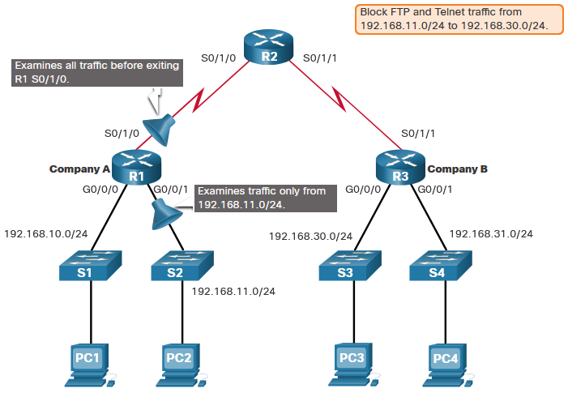
Implement ACLs
Extended ACL Placement Example
Extended ACLs should be located as close to the source as possible. This prevents unwanted traffic from being sent across multiple networks only to be denied when it reaches its destination. However, the organization can only place ACLs on devices that they control. Therefore, the extended ACL placement must be determined in the context of where organizational control extends.
Company A wants to deny Telnet and FTP traffic to Company B’s 192.168.30.0/24 network from their 192.168.11.0/24 network while permitting all other traffic.
Notes:
8: Access Control Lists 8.5: Implement ACLs 8.5.7: Extended ACL Placement Example
8.5.8: Check Your Understanding - Guidelines for ACL Placement
8.5.9: Check Your Understanding- Configuring Standard ACLs
8.5.10: Check Your Understanding- Creating an Extended ACL Statement
8.5.11: Check Your Understanding- Evaluating Extended ACLs

Slide 46
Implement ACLs
Packet Tracer- Configuring Extended ACLs Scenario 1
In this Packet Tracer activity, you will complete the following objectives:
Part 1: Configure, Apply, and Verify an Extended Numbered IPv4 ACL
Part 2: Configure, Apply, and Verify an Extended Named IPv4 ACL
Notes:
8: Access Control Lists 8.5: Implement ACLs 8.5.12: Packet Tracer- Configuring Extended ACLs Scenario 1

Slide 47
Implement ACLs
Packet Tracer - Configuring Extended ACLs Scenario 2
In this Packet Tracer activity, you will complete the following objectives:
Part 1: Configure a Named Extended IPv4 ACL
Part 2: Apply and Verify the Extended IPv4 ACL
Notes:
8: Access Control Lists 8.5: Implement ACLs 8.5.13: Packet Tracer - Configuring Extended ACLs Scenario 2

Slide 48
8.6 Mitigate Attacks with ACLs
Notes:
8: Access Control Lists 8.6: Mitigate Attacks with ACLs

Slide 49
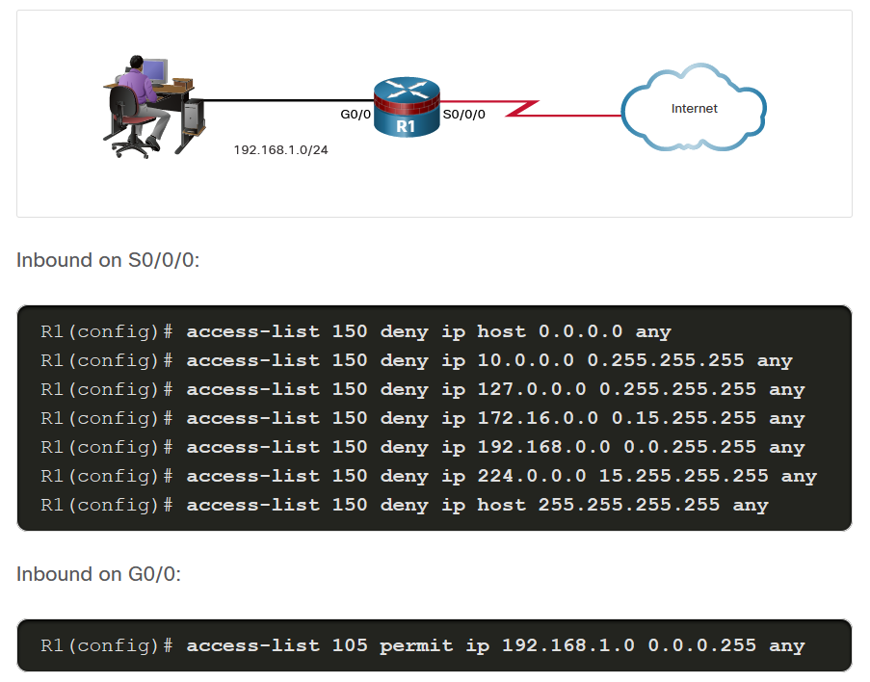
Mitigate Attacks with ACLs
Mitigate Spoofing Attacks
IP address spoofing overrides the normal packet creation process by inserting a custom IP header with a different source IP address. There are many well-known classes of IP addresses that should never be source IP addresses for traffic entering an organization’s network. The S0/0/0 interface is attached to the internet and should never accept inbound packets from the following addresses:
All zeros addresses
Broadcast addresses
Local host addresses (127.0.0.0/8)
Automatic Private IP Addressing (APIPA) addresses (169.254.0.0/16)
Reserved private addresses (RFC 1918)
IP multicast address range (224.0.0.0/4)
Notes:
8: Access Control Lists 8.6: Mitigate Attacks with ACLs 8.6.1: Mitigate Spoofing Attacks

Slide 50
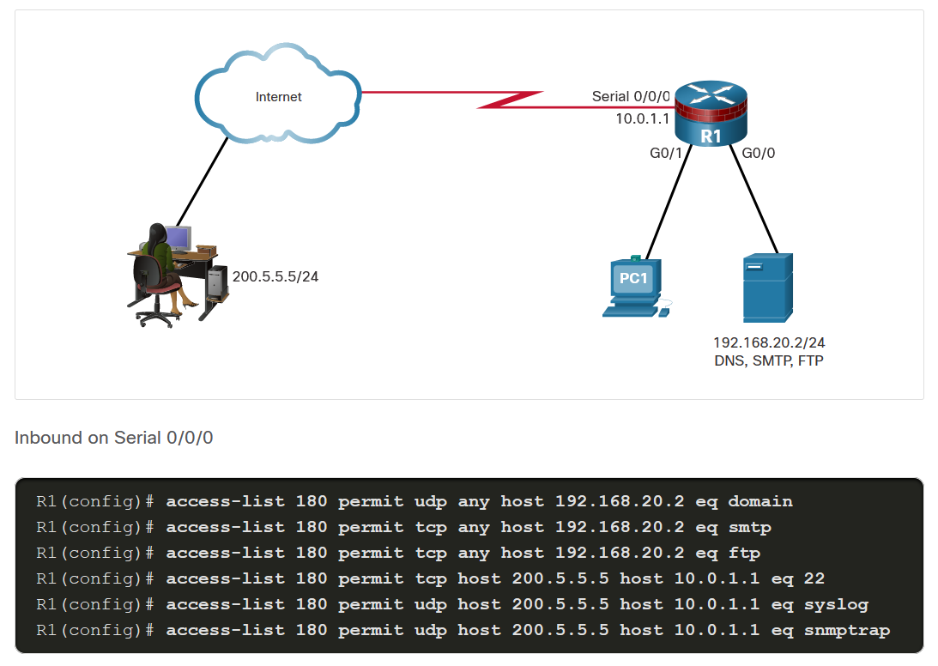
Mitigate Attacks with ACLs
Permit Necessary Traffic through a Firewall
An effective strategy for mitigating attacks is to explicitly permit only certain types of traffic through a firewall. For example, Domain Name System (DNS), Simple Mail Transfer Protocol (SMTP), and File Transfer Protocol (FTP) are services that often must be allowed through a firewall. Secure Shell (SSH), syslog, and Simple Network Management Protocol (SNMP) are examples of services that a router may need to include. The figure shows an example topology with ACL configurations to permit specific services on the Serial 0/0/0 interface.
Notes:
8: Access Control Lists 8.6: Mitigate Attacks with ACLs 8.6.2: Permit Necessary Traffic through a Firewall

Slide 51
Mitigate Attacks with ACLs
Mitigate ICMP Attacks
Both ICMP echo and redirect messages should be blocked inbound by the router. Several ICMP messages are recommended for proper network operation and should be allowed into the internal network:
Echo reply - Allows users to ping external hosts.
Source quench - Requests that the sender decrease the traffic rate of messages.
Unreachable - Generated for packets that are administratively denied by an ACL.
Several ICMP messages are required for proper network operation and should be allowed to exit the network:
Echo - Allows users to ping external hosts.
Parameter problem - Informs the host of packet header problems.
Packet too big - Enables packet maximum transmission unit (MTU) discovery.
Source quench - Throttles down traffic when necessary.
As a rule, block all other ICMP message types outbound.
Notes:
8: Access Control Lists 8.6: Mitigate Attacks with ACLs 8.6.3: Mitigate ICMP Attacks

Slide 52
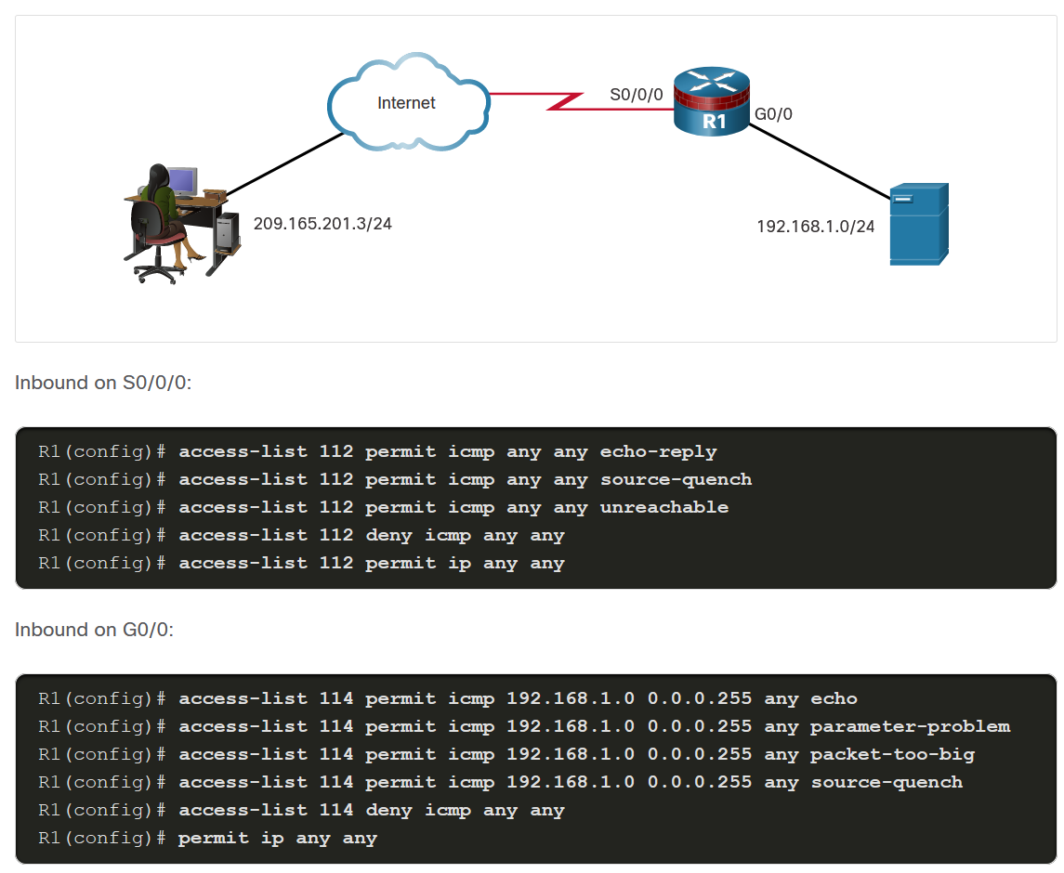
Mitigate Attacks with ACLs
Mitigate ICMP Attacks (Cont.)
The example shows a sample topology and possible ACL configurations to permit specific ICMP services on the G0/0 and S0/0/0 interfaces.
Notes:
8: Access Control Lists 8.6: Mitigate Attacks with ACLs 8.6.3: Mitigate ICMP Attacks

Slide 53
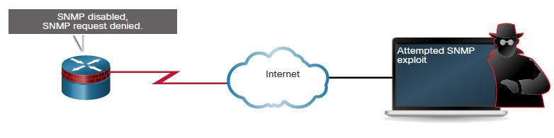
Mitigate Attacks with ACLs
Mitigate SNMP Attacks
Exploitation of SNMP vulnerabilities can be mitigated by applying interface ACLs to filter SNMP packets from non-authorized systems. These security measures are helpful, but the most effective means of exploitation prevention is to disable the SNMP server on IOS devices for which it is not required. Use the command no snmp-server to disable SNMP services on Cisco IOS devices.
Notes:
8: Access Control Lists 8.6: Mitigate Attacks with ACLs 8.6.4: Mitigate SNMP Attacks

Slide 54
Mitigate Attacks with ACLs
Packet Tracer - Configure IP ACLs to Mitigate Attacks
In this Packet Tracer, you will complete the following objectives:
Verify connectivity among devices before firewall configuration.
Use ACLs to ensure remote access to the routers is available from only management station PC-C.
Configure ACLs on R1 and R3 to mitigate attacks.
Verify ACL functionality.
Notes:
8: Access Control Lists 8.6: Mitigate Attacks with ACLs 8.6.5: Packet Tracer - Configure IP ACLs to Mitigate Attacks

Slide 55
8.7 IPv6 ACLs
Notes:
8: Access Control Lists 8.7: IPv6 ACLs

Slide 56
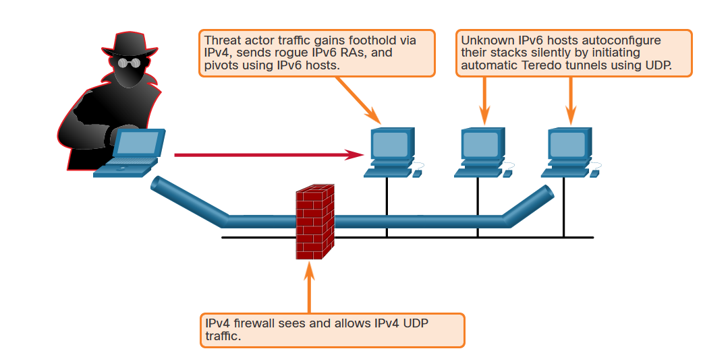
IPv6 ACLs
IPv6 ACL Overview
As the migration to IPv6 continues, IPv6 attacks are becoming more pervasive. IPv4 will not disappear overnight. IPv4 will coexist with IPv6 and then gradually be replaced by IPv6. This creates potential security holes. An example of a security concern is attackers leveraging IPv4 to exploit IPv6 in dual stack environments.
As shown in the figure, threat actors can accomplish stealth attacks that result in trust exploitation by using dual-stacked hosts, rogue Neighbor Discovery Protocol (NDP) messages, and tunneling techniques. To protect against these threats, filter at the edge using various techniques, such as IPv6 ACLs.
Notes:
8: Access Control Lists 8.7: IPv6 ACLs 8.7.1: IPv6 ACL Overview

Slide 57
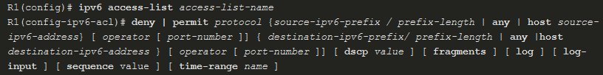
IPv6 ACLs
IPv6 ACL Syntax
The ACL functionality in IPv6 is like ACLs in IPv4. However, there is no equivalent to IPv4 standard ACLs. All IPv6 ACLs must be configured with a name. IPv6 ACLs allow filtering based on source and destination addresses that are traveling inbound and outbound to a specific interface. They also support traffic filtering based on IPv6 option headers and optional, upper-layer protocol type information for finer granularity of control, like extended ACLs in IPv4.
To configure an IPv6 ACL, use the ipv6 access-list command to enter into IPv6 ACL configuration mode. Next, use the syntax shown in the figure to configure each access list entry to specifically permit or deny traffic. Apply an IPv6 ACL to an interface with the ipv6 traffic-filter command.
Notes:
8: Access Control Lists 8.7: IPv6 ACLs 8.7.2: IPv6 ACL Syntax

Slide 58
IPv6 ACLs
IPv6 ACL Syntax (Cont.)
Parameter | Description
deny | permit | Specifies whether to deny or permit the packet.
protocol | Enter the name or number of an Internet protocol, or an integer representing an IPv6 protocol number.
source-ipv6-prefix/prefix-length destination-ipv6-address/prefix-length | The source or destination IPv6 network or class of networks for which to set deny or permit conditions.
any | Enter any as an abbreviation for the IPv6 prefix ::/0. This matches all addresses.
host | For host source-ipv6-address or destination-ipv6-address , enter the source or destination IPv6 host address for which to set deny or permit conditions.
operator | (Optional) An operand that compares the source or destination ports of the specified protocol. Operands are lt (less than), gt (greater than), eq (equal), neq (not equal), and range.
port-number | (Optional) A decimal number or the name of a TCP or UDP port for filtering TCP or UDP, respectively.
(table continued on next slide)
Notes:
8: Access Control Lists 8.7: IPv6 ACLs 8.7.2: IPv6 ACL Syntax (Cont.)

Slide 59
IPv6 ACLs
IPv6 ACL Syntax (Cont.)
Parameter | Description
dscp | (Optional) Matches a differentiated services codepoint value against the traffic class value in the Traffic Class field of each IPv6 packet header. The acceptable range is from 0 to 63.
fragments | (Optional) Matches non-initial fragmented packets where the fragment extension header contains a non-zero fragment offset. The fragments keyword is an option only if the operator [port-number ] arguments are not specified. When this keyword is used, it also matches when the first fragment does not have Layer 4 information.
log | (Optional) Causes an informational logging message about the packet that matches the entry to be sent to the console. (The level of messages logged to the console is controlled by the logging console command.)
log input | (Optional) Provides the same function as the log keyword, except that the logging message also includes the input interface.
sequence value | (Optional) Specifies the sequence number value for the access list statement. The acceptable range is from 1 to 4294967295.
time-range name | (Optional) Specifies the time range that applies to the permit statement. The name of the time range and its restrictions are specified by the time-range and absolute or periodic commands, respectively.
Notes:
8: Access Control Lists 8.7: IPv6 ACLs 8.7.2: IPv6 ACL Syntax (Cont.)

Slide 60
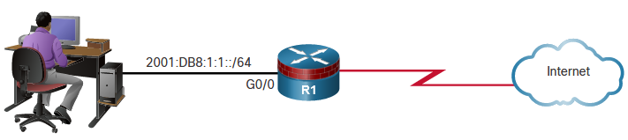
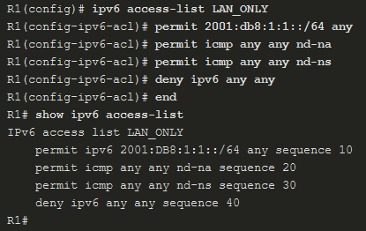
IPv6 ACLs
Configure IPv6 ACLs
An IPv6 ACL contains an implicit deny ipv6 any command. Each IPv6 ACL also contains implicit permit rules to enable IPv6 neighbor discovery. The IPv6 NDP requires the IPv6 network layer to send neighbor advertisements (NAs) and neighbor solicitations (NSs). If an administrator configures the deny ipv6 any command without explicitly permitting neighbor discovery, then the NDP will be disabled.
R1 is permitting inbound traffic on G0/0 from the 2001:DB8:1:1::/64 network. NA and NS packets are explicitly permitted. Traffic sourced from any other IPv6 address is explicitly denied. If the administrator only configured the first permit statement, the ACL would have the same effect. However, it is a good practice to document the implicit statements by explicitly configuring them.
Notes:
8: Access Control Lists 8.7: IPv6 ACLs 8.7.3: Configure IPv6 ACLs

Slide 61
IPv6 ACLs
Packet Tracer - Configure IPv6 ACLs
In this Packet Tracer, you will complete the following objectives:
Configure, apply, and verify an IPv6 ACL
Configure, apply, and verify a second IPv6 ACL
Notes:
8: Access Control Lists 8.7: IPv6 ACLs 8.7.4: Packet Tracer - Configure IPv6 ACLs

